Slide 1
Contd.,

Slide 2
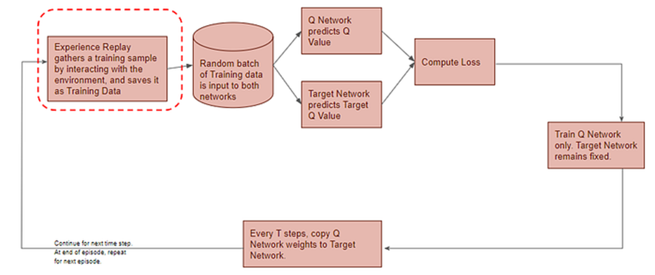
First phase

Slide 3
Epsilon –Greedy Action

Slide 4
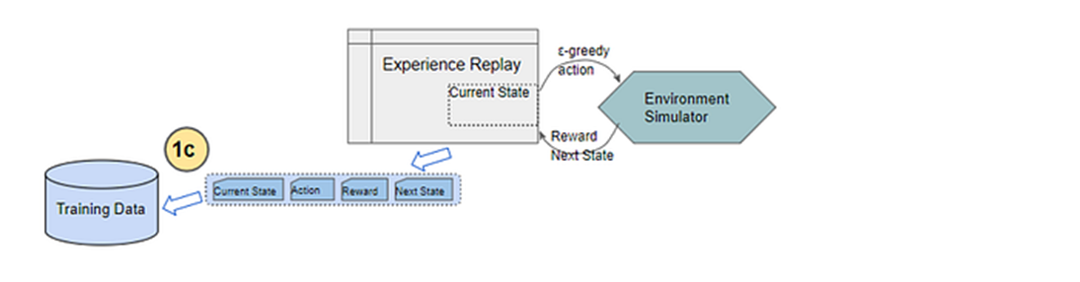
Experience Replay

Slide 5
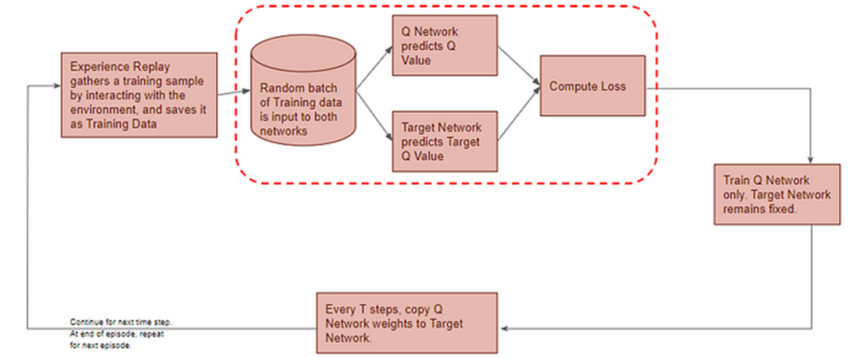
Next phase of the flow

Slide 6
Q Network predicts Q-value
All prior Experience Replay observations are saved as training data. We now take a random batch of samples from this training data, so that it contains a mix of older and more recent samples.
This batch of training data is then inputted to both networks. The Q network takes the current state and action from each data sample and predicts the Q value for that particular action. This is the ‘Predicted Q Value’.

Slide 7
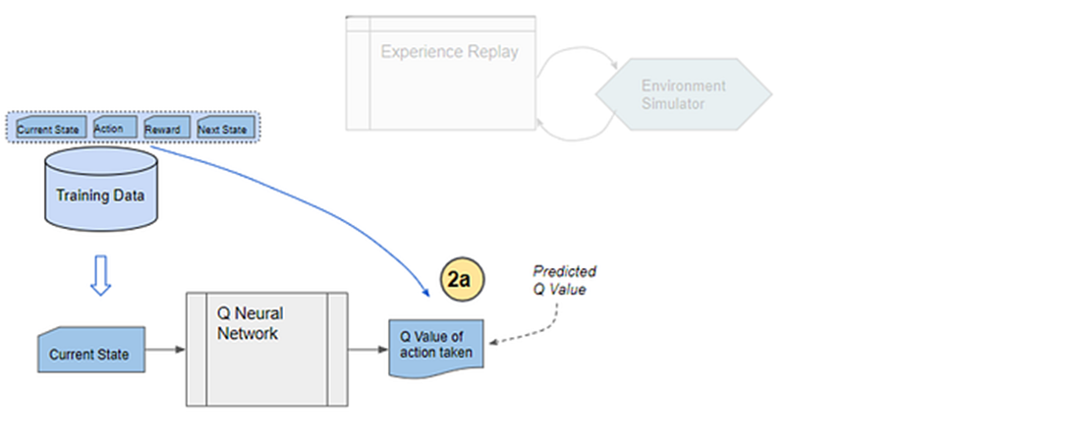
Predicted Q value

Slide 8
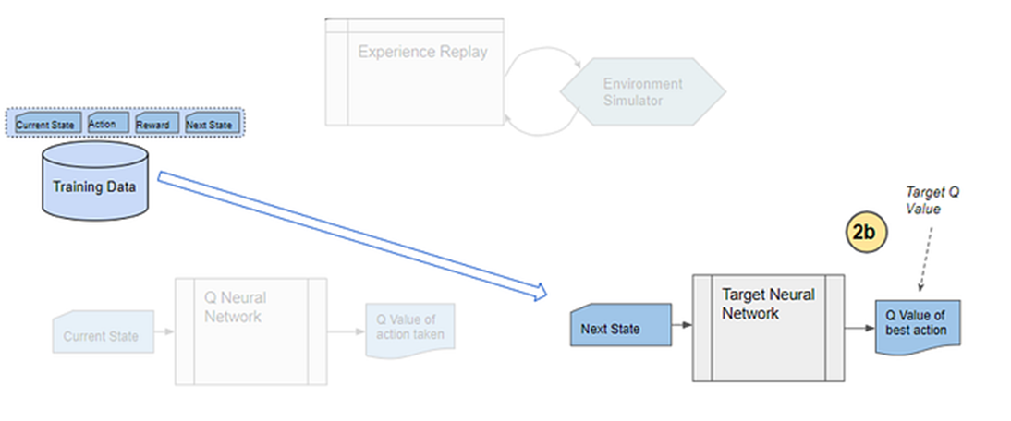
Target Network predicts Target Q-value
The Target network takes the next state from each data sample and predicts the best Q value out of all actions that can be taken from that state. This is the ‘Target Q Value’.

Slide 9
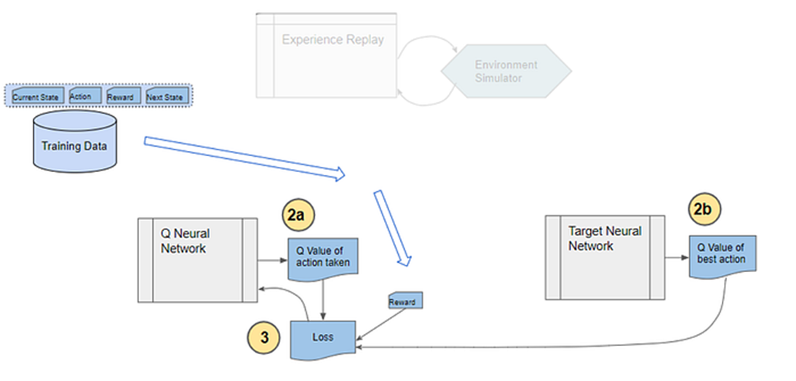
Compute Loss and Train Q Network
The Predicted Q Value, Target Q Value, and the observed reward from the data sample is used to compute the Loss to train the Q Network. The Target Network is not trained.

Slide 10
Why do we need Experience Replay?
Would that occur if we passed a batch of data from sequential actions? Let’s take a scenario of a robot learning to navigate a factory floor. Let’s say that at a certain point in time, it is trying to find its way around a particular corner of the factory. All of the actions that it would take over the next few moves would be confined to that section of the factory.
If the network tried to learn from that batch of actions, it would update its weights to deal specifically with that location in the factory. But it would not learn anything about other parts of the factory. If sometime later, the robot moves to another location, all of its actions and hence the network’s learnings for a while would be narrowly focused on that new location. It might then undo what it had learned from the original location.
Hopefully, you’re starting to see the problem here. Sequential actions are highly correlated with one another and are not randomly shuffled, as the network would prefer. This results in a problem called Catastrophic Forgetting where the network unlearns things that it had learned a short while earlier.

Slide 11
This is why the Experience Replay memory was introduced. All of the actions and observations that the agent has taken from the beginning (limited by the capacity of the memory, of course) are stored. Then a batch of samples is randomly selected from this memory. This ensures that the batch is ‘shuffled’ and contains enough diversity from older and newer samples (eg. from several regions of the factory floor and under different conditions) to allow the network to learn weights that generalize to all the scenarios that it will be required to handle.

Slide 12
Why do we need a second neural network (Target Network)?
The second puzzling thing is why we need a second neural network? And that network is not getting trained, so that makes it all the more puzzling.
Firstly, it is possible to build a DQN with a single Q Network and no Target Network. In that case, we do two passes through the Q Network, first to output the Predicted Q value, and then to output the Target Q value.
But that could create a potential problem. The Q Network’s weights get updated at each time step, which improves the prediction of the Predicted Q value. However, since the network and its weights are the same, it also changes the direction of our predicted Target Q values. They do not remain steady but can fluctuate after each update. This is like chasing a moving target 😄.
By employing a second network that doesn’t get trained, we ensure that the Target Q values remain stable, at least for a short period. But those Target Q values are also predictions after all and we do want them to improve, so a compromise is made. After a pre-configured number of time-steps, the learned weights from the Q Network are copied over to the Target Network.

Slide 13
DQN Operation in depth…………..

